Slide 1
dna

Slide 2
What is DNA?
DNA stands for deoxyribonucleic acid
DNA is often referred to as the molecule of life. It is found in almost all living things. It acts as a type of chemical code that contains instructions, known as genes, for how the body and all its different parts grow, develop, function, and maintain themselves.

Slide 3
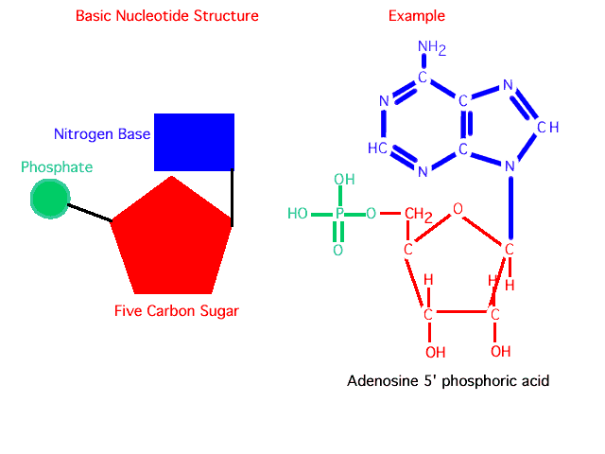
DNA Structure
The basic unit of DNA is the nucleotide, which is composed of deoxyribose (a sugar) bonded to both a phosphate group and a nitrogenous base

Slide 4
Dna structure
There are two types of bases: the double-ringed purines and the single-ringed pyrimidines.
Purines in DNA are adenine (A) and guanine (G)
Ariana Grande
Pyrimidines are cytosine (C) and thymine (T)
Channing Tatum

Slide 5
Purines
Pyrimidines

Slide 6
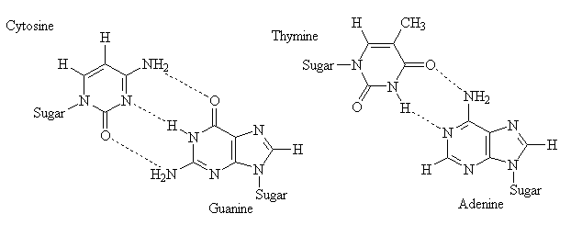

Slide 7
DNA Structure
DNA backbone is composed of sugar-phosphate bonds
DNA ladder rungs are composed of nitrogenous base pairs
Thymine – Adenine (AT)
Guanine – Cytosine (GmC)
DNA is a double-stranded helix with the sugar-phosphate chains on the outside of the helix and the bases on the inside

Slide 9
DNA Structure
The DNA strands are positioned antiparallel to each other; one strand has a 5’ → 3’ polarity and it’s complementary strand has a 3’ → 5’ polarity.
5’ = phosphate group
3’ = sugar end

Slide 10
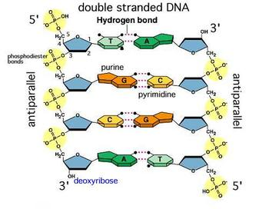
Sugar
Phosphate

Slide 11
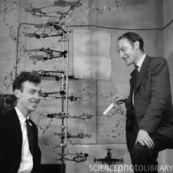
DNA Structure
The antiparallel double stranded model of DNA was first recognized by James Watson and Francis Crick in 1953
Nobel Peace Prize in 1962

Slide 12
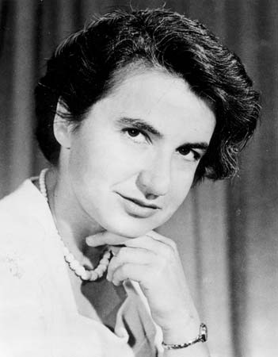
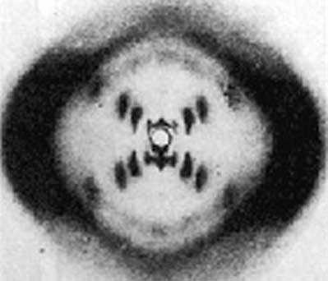
Rosaland Franklin
X-ray diffraction

Slide 13
DNA Storage

Slide 14
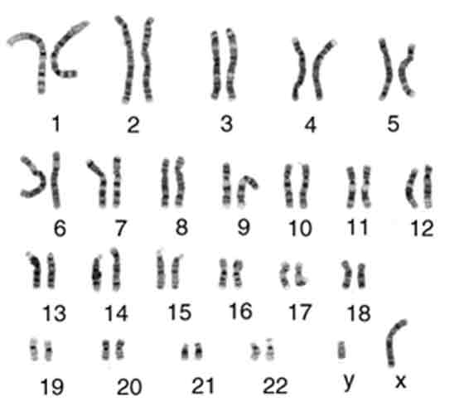
How is DNA Stored?
DNA is packaged into 46 X-shaped elements called chromosomes, which are situated in the cells nucleus.

Slide 15
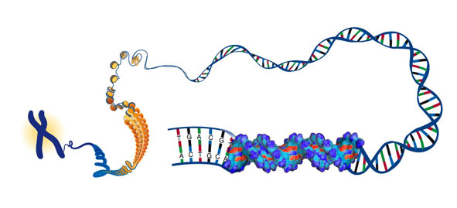
chromosome

Slide 17
DNA Replication

Slide 19
What is the purpose of DNA Replication?
DNA has the ability to self replicate, which is crucial for cell division and for the organismal reproduction
Self-replication ensures that its coded sequence will be passed on to successive generations

Slide 20
3 steps to semi-conservative replication of dna
“unzipping” (DNA helicase)
Complementary base pairing (DNA Polymerase)
Joining of adjacent nucleotides (DNA Polymerase)

Slide 21
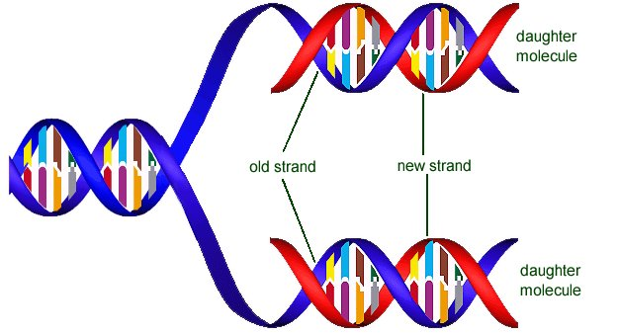
In order for cells to grow and divide, they must be able to make new copies of DNA that they can pass on to their daughter cells. This process is called DNA replication.
Notes:
3.4.1 – Explain DNA replication in terms of unwinding the double helix and separation of the strands by helicase, followed by formation of the new complementary strands by DNA polymerase.
It is not necessary to mention that there is more than one DNA polymerase

Slide 22
DNA Replication
Semi-conservative replication
During replication, the helix unwinds, and each strand acts as a template for commentary base-pairing in the synthesis of two new daughter helices.
Each new daughter helix contains an intact strand from the parent helix and a newly synthesized strand; thus, DNA replication is semiconservative.
The daughter DNA helices are identical in composition to each other and to the parent DNA.

Slide 23
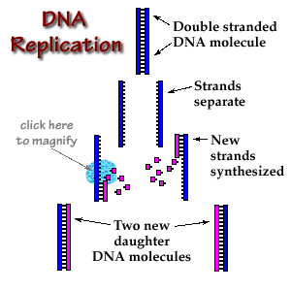

Slide 24
DNA Replication
As the helix unwinds, both strands are simultaneously copied with the aid of more than a dozen enzymes at the rate of about 50 nucleotide additions per second (in mammals).
Replication begins at specific sites along the DNA called origins of replication and proceeds in both directions simultaneously.

Slide 25
DNA Replication
In the first step of replication, the enzyme DNA Helicase unwinds the double helix . while single-stranded binding protein (SSB) binds to the single strands and stabilizes them, preventing them from recoiling and reforming a double helix
It then separates the DNA strands by breaking the hydrogen bonds between the bases.

Slide 26
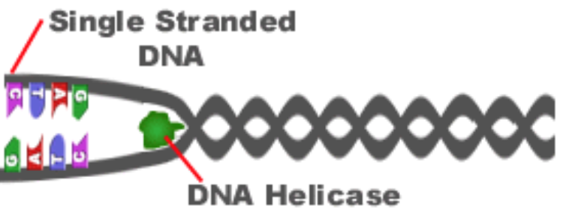
Unzipping the two strands allows access to the individual nucleotides that are needed for the replication process to continue.
Notes:
3.4.1 – Explain DNA replication in terms of unwinding the double helix and separation of the strands by helicase, followed by formation of the new complementary strands by DNA polymerase.
It is not necessary to mention that there is more than one DNA polymerase

Slide 27
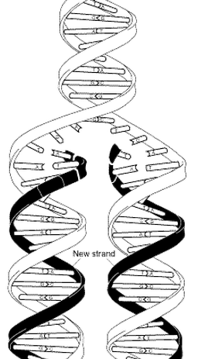
Next, DNA polymerase enzymes attach to the newly separated strands of DNA. The enzyme then uses free nucleotides and synthesizes complementary strands by reading the original strands.
When the process is finished, two identical DNA strands have been produced.
Notes:
3.4.1 – Explain DNA replication in terms of unwinding the double helix and separation of the strands by helicase, followed by formation of the new complementary strands by DNA polymerase.
It is not necessary to mention that there is more than one DNA polymerase

Slide 28
During the process of synthesizing DNA, DNA polymerase reads the original strands and adds complementary base pairs. See below for an example.
3’ TGCCAAGGCTTGAG 5’
5’ ACGGTTCCGAACTC 3’
5’ ACGGTTCCGAACTC 3’
3’ TGCCAAGGCTTGAG 5’
3’ TGCCAAGGCTTGAG 5’
5’ ACGGTTCCGAACTC 3’
This complementary base pairing is important for conserving the base sequence of DNA. It ensures that each new strand is identical to the original.
3.4.2
Notes:
3.4.2 – Explain the significance of complementary base pairing in the conservation of the base sequence of DNA.

Slide 29
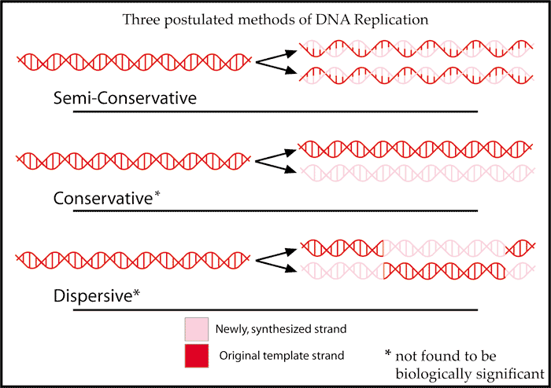
DNA replication is considered to be semiconservative because each of the parent strands serves as a template and make up half of the resulting copies.
New DNA strands are 50% new and 50% old
3.4.3
Notes:
3.4.3 – State that DNA replication is semi-conservative.

Slide 30
DNA Replication
DNA synthesis proceeds in the 5’ → 3’ direction and is catalyzed by a group of enzymes collectively known as DNA polymerase
the double stranded DNA ahead of the DNA polymerase is unwound by a helicase, and SSB keeps the unwound DNA stable
As the helix unwinds, free nucleotides are aligned opposite the parent strands

Slide 31
DNA Replication
One daughter strand is the leading strand, and the other daughter strand is the lagging strand.
The leading strand is continuously synthesized by DNA polymerase in the 5’ → 3’ direction
The lag strand is synthesized discontinuously in the 5’ → 3’ direction as a series of short segments known as Okazaki fragments; however, overall growth of the lagging strand occurs in the 3’ → 5’ direction
The lagging strand loops through DNA polymerase in the same direction as the leading strand. The looped segment of the lagging strand is primed with RNA and DNA polymerase adds a short sequence of nucleotides (~1000). The lagging strand is released, and a new loop is formed.

Slide 32
Protein synthesis

Slide 33
DNA →(transcription)→ mRNA
mRNA → (translation) → Proteins

Slide 34
Messenger RNA
The purpose of messenger RNA is to transfer the information from DNA within the cell to outside the cell (recall that DNA cannot leave the nucleus).
Transcription: is the process by which the DNA code is dictated to mRNA, that is then delivers its message into the cytoplasm.

Slide 35
DNA →(transcription)→ mRNA
mRNA → (translation) → Proteins
(late)

Slide 36
translation
Translation occurs in the cytoplasm, where the purpose of DNA is fulfilled by newly created proteins that perform functions vital to the lives of cells and organisms.

Slide 37
translation
After mRNA is transcribed in the nucleus, it moves into the cytoplasm to direct the formation of a polypeptide (amino acid chain). A protein may be made from one or more polypeptides.
The order is specific

Slide 38
codon
Three-nucleotide unit on the mRNA strand
Different codons code for different amino acids

Slide 39
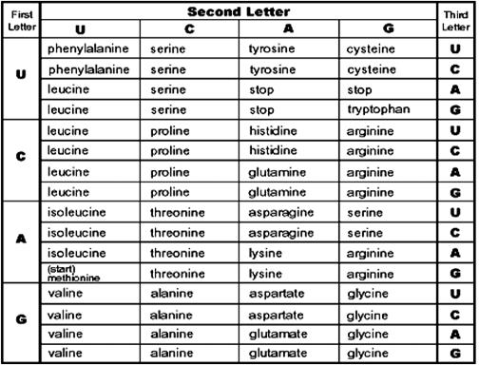

Slide 40
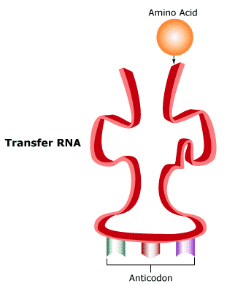
Protein synthesis
Protein synthesis occurs at the ribosomes located on rough endoplasmic reticulum. After mRNA leaves the nucleus, it proceeds to the ribosomes. It is the job of tRNA to bring amino acids to the site of protein synthesis

Slide 41
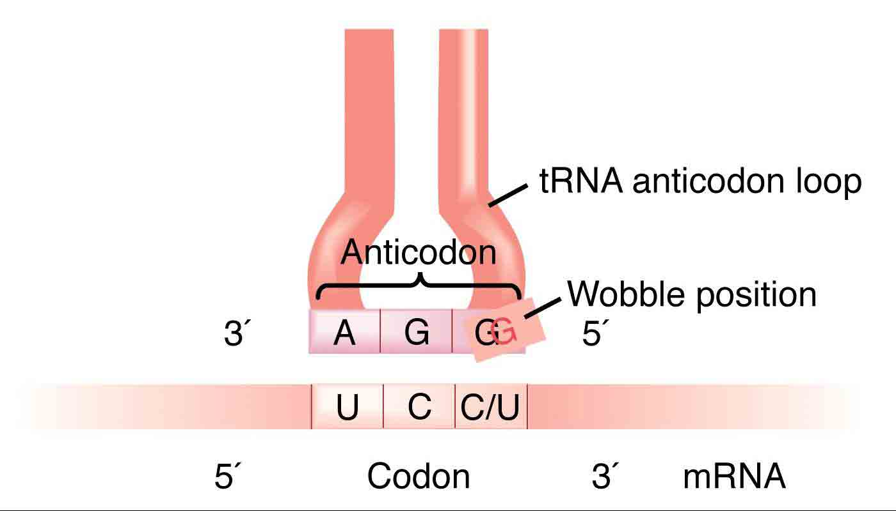
Codon & anticodon

Slide 42
Transfer rna

